Slide 1
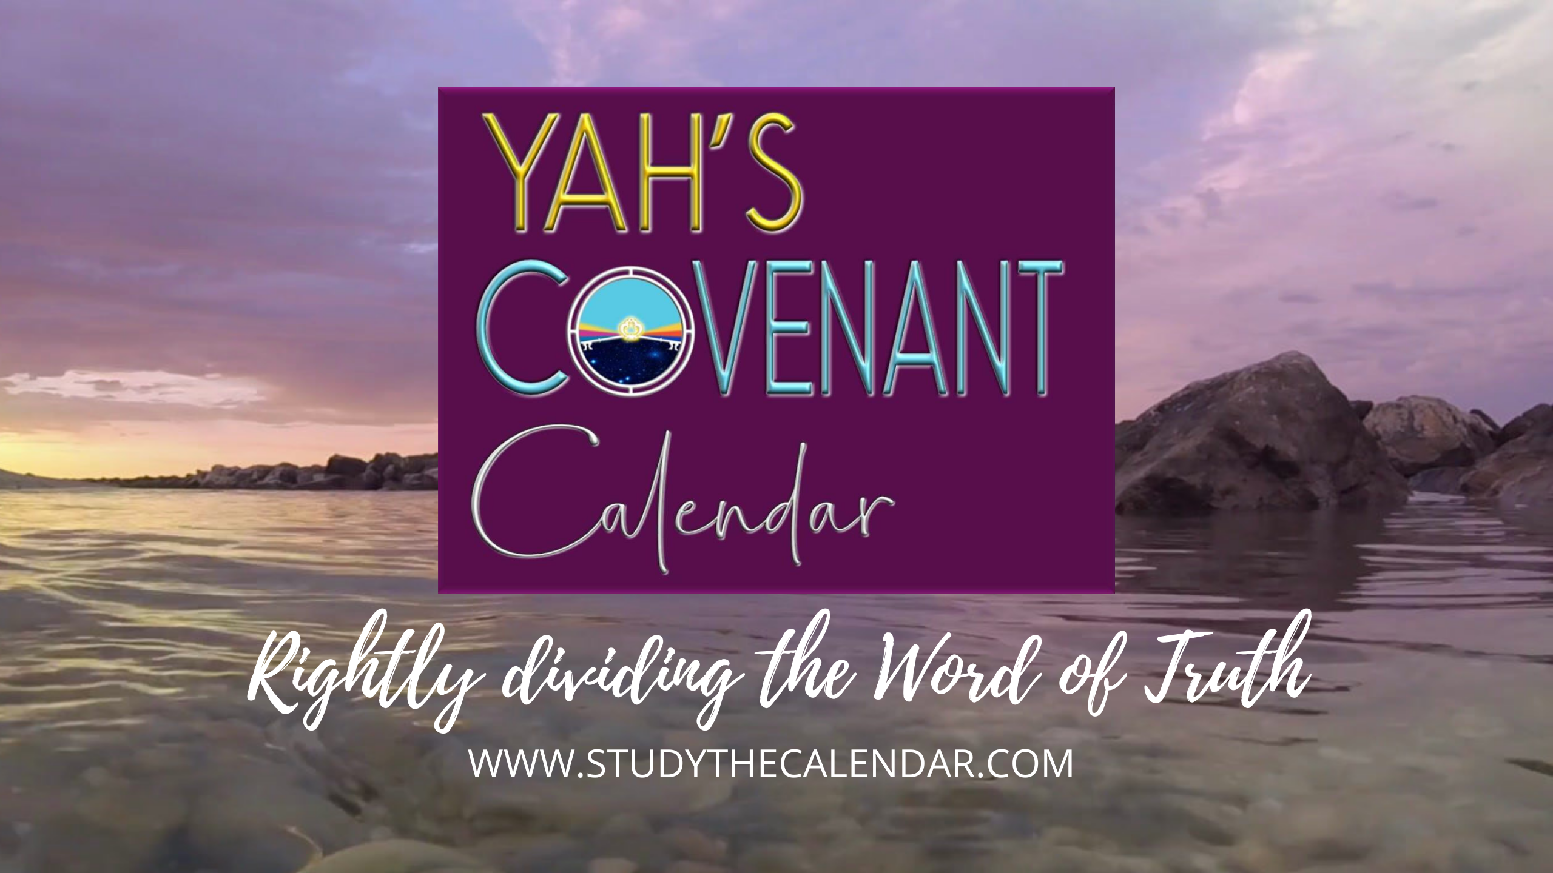
The Moon! Oh, the Moon! Pt 8

Slide 2



Everyone Wants to KNOW the
The Moon! Oh, the Moon!
2
Part 8: “Yahuah’s People Seek After Pagan Gods!”
Our Question: Why would Yahuah’s people be
enticed to exchange their worship for pagan gods?

Slide 3

hey, mr. graduate, our last teaching exposed the 1611 translators as having deliberate intentions to uphold some Jewish
calendar traditions.
yes, but the translators should not have to bear all of the fault for the calendar problems we are now dealing with.
today we are going
to examine the Old
Testament history
from Adam up to
700 BC to understand
where, when & how
Yahuah’s people came to adopt sun & moon calendars!
let’s start with a review.
3

Slide 4
Mapping the Topics for H2320 <chodesh>
R
E
V
I
E
W
H2320 <chodesh> must come into alignment with Moses & Torah as Yahuah’s “new [chodesh] month”
not Yahuah’s “new moon” or man’s agenda.
1. H2320 Definition
Examination of Theologian’s Hebrew Lexicon Study Tools: 1) Strong’s; 2) Brown-Driver-Briggs; 3) Gesenius;
4) Theological Wordbook of the Old Testament (TWOT).
2. Lexicon Challenges
From 1450 BC [2550 years after creation]: The Torah Calendar Instructions were for all Kings, Prophets and Leaders, up to and including Yahuah’s people today.
R
E
V
I
E
W
3. Counsel from Moses
All 20 “new moon” verses are NON-Torah references mis-translating <chodesh> as “moon” instead of “month.” Not one verse aligned with Torah instructions!
4. New Moon Verses
4

Slide 5
Mapping the Topics for H2320 <chodesh>
1611 KJV Translators and their treatment
of H2320 <chodesh> in Isaiah 47:13:
Did they make a deliberate mistake or not?
R
E
V
I
E
W
5. 1611 KJV Translators
Examination of 10 different translations
(of many) that clearly give the true context
for Isaiah 47:13.
6. Bible Translations
Examination of 3 Bible Commentators for their insight into the proper meaning and history of
Isaiah 47:13.
7. Bible Commentators
Mapping the Topics for Tanach History
The Old Testament history search will begin with Adam to Noah to see if any patriarchs were involved in the worship of ‘no gods.’
NEW
8. Adam to Noah
5

Slide 6
Mapping the Topics for Tanach History
~700 years after the flood: Nimrod was worshipped as a ‘no god.’ Did this happen when he was living, or only after he had died? Does it matter?
9. Flood to Nimrod
NEW
L
E
S
SON
Terah and his family lived in the area of Babylon called Ur of the Chaldees where ‘no gods’ were worshipped. Was Terah influenced as well?
10. Terah & ‘no gods’
Egypt also worshipped many ‘no gods’ while Yahuah’s people were in bondage there.
How did this affect the experience at Mt Sinai?
11. Egypt & ‘no gods’
Joshua trained under Moses, the last Melchizedek priest. His mandate was to clear the land of idols. What was his last plea to Yahuah’s people?
12. Joshua & ‘no gods’
6

Slide 7
Mapping the Topics for Tanach History
There are 1000s of ‘no gods’ worshipped in this world today. However, who are the two main OT ‘no gods’ that contend for divine worship?
13. Two main ‘no gods’
NEW
L
E
S
SON
The “groves and high places” were specifically designed for the worship of one ‘no god.’ Could there be a link back to the Garden of Eden?
14. Groves & a Garden
From the heels of Joshua’s excellent leadership, Judges (and up to 700 BC) documents the seriousness of the worship of ‘no gods’ … on which calendar?
15. Judges to 700 BC
This study is best conducted by placing everything in order of date to see the picture of exactly what is happening. Plan to share your comments.
16. Audience Participation
7

Slide 8
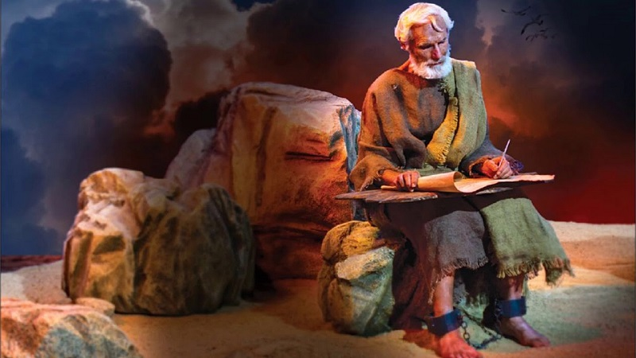
Reminder from john the beloved
John 21:25
KJV
“And there are also many other things which Yahusha did, the which, if they should be written every one, I suppose that even the world itself could not contain the books that should be written.”
This is likely the very last verse John ever penned in the New Testament!
If the whole world can not contain every detail of Yahusha’s life on earth, it would be impossible for the Scriptures to give every detail of the Old Testament historical facts. That means every single word in the Scriptures is of extreme importance. We must search to find all the puzzle pieces that are given in these “Words” to know the whole truth!

Slide 9
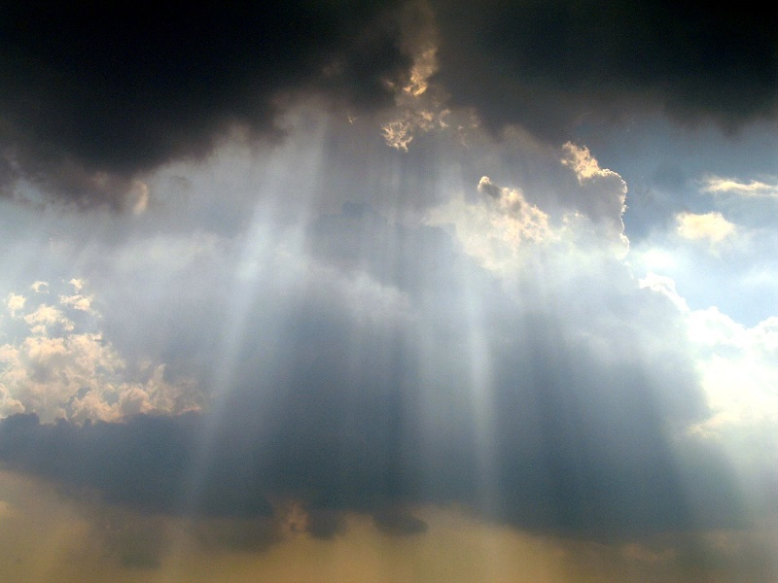
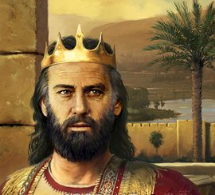
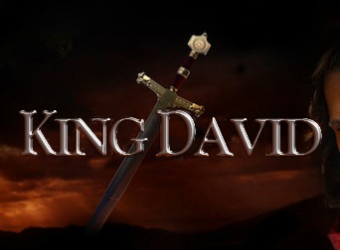
Psalm 24:3-4
NKJV
Who may ascend into the hill of Yahuah?
Or who may stand in His holy place?
He who has clean hands and a pure heart,
Who has not lifted up his soul to an idol.
How would this thought be linked to calendar?

Slide 10
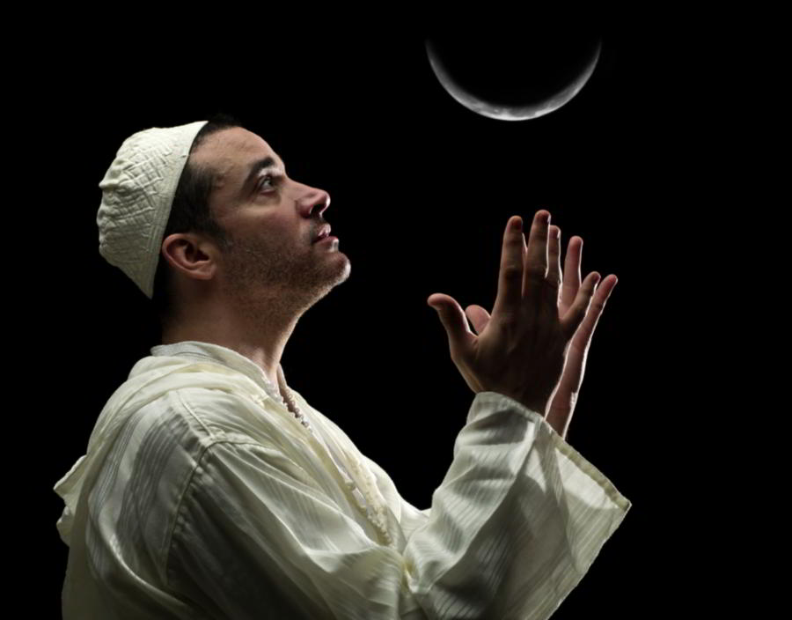
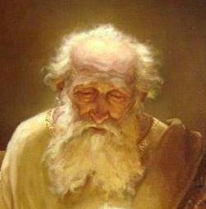
Jews and the Moon
Most Christians that know anything about the Scriptures, or Jewish beliefs, also know the Jews follow the moon to calculate their Biblical month.
Because of this, most make the assumption (and believe) the Festal month really is based on the moon.
Job 31:26-28 (New Living Translation)
26 Have I looked at the sun shining in the skies,
or the moon walking down its silver pathway,
27 and been secretly enticed in my heart
to worship them?
28 If so, I should be punished by the judges,
for it would mean I had denied Yahuah of heaven.

Slide 11
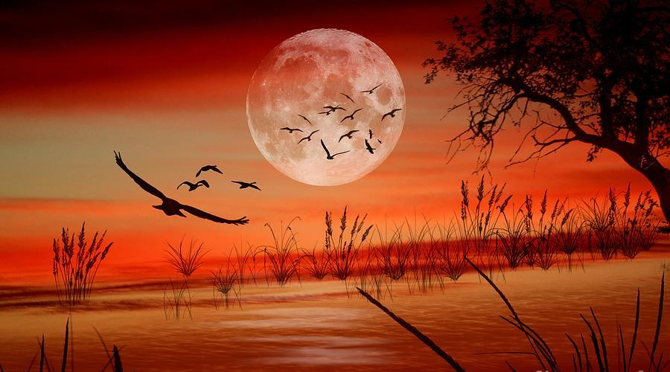
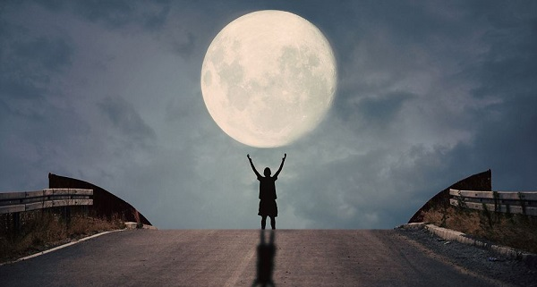
Is the Moon really in charge
of the Festal Biblical Month?
Is there a Lunar Deception?
11

Slide 12
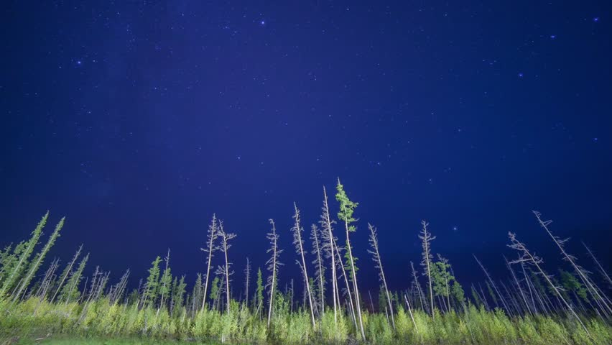
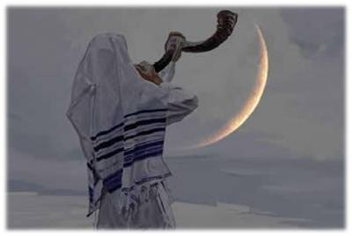
Or are we dealing with something much more serious?
A Lunatic Authority?
12

Slide 13

Questions that Need Answers for this Study
Where did sun and moon worship really begin?
Did this happen somewhere between the generations of Adam and Noah?
Do the sun god and moon goddess represent the major
“no gods” or are there other more important pagan gods?
If the sun god and moon goddess are the dominant pagan gods, which one of the two takes the #1 position?
If sacred regard is given to the sun and moon for any reason, is this classed as worship?
If the sighting of the sun and moon are part of the worship calendar, is that action regarded as worship or serving?
Will this study be able to conclude which is more deceptive? Sun worship, or moon worship?

Slide 14
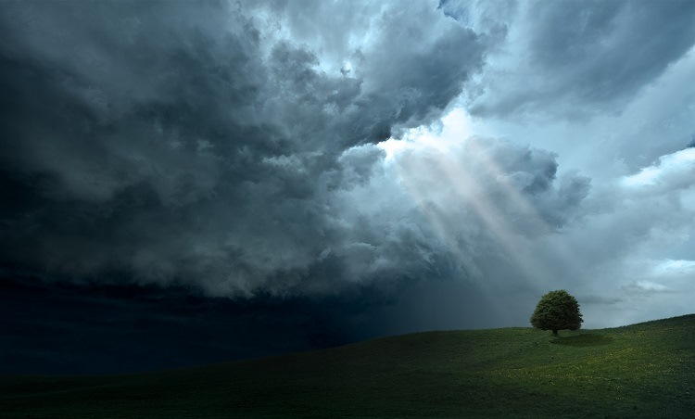
Job & the Moon …
Was it a Mystery?
At the time of Abraham, Yahuah’s people were known as Hebrews.
Job lived around the time of Abraham – long before the 12 tribes of Israel, or any Jews. He would not be secretly enticed with the moon.
This study will examine the history beginning with Adam to Noah.
Then we will examine the history from Shem to Abraham, and the
Old Testament history of the northern tribes of Israel (today) and
the tribe of Judah (next time).
The “moon” mystery will be solved through understanding the history.

Slide 15
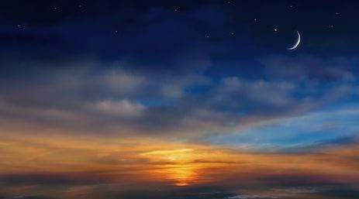

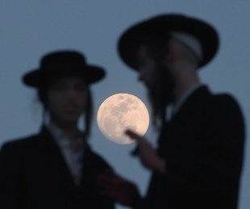
Jews & their Moon -
Are we dealing with a Secret?
Most people believe the Jews (today) are
correct in following certain phases of the moon in
connection with their feast and festival worship statutes.
The 2 verses in Deut 4 & 17 deliver a strong statute warning against regarding the moon for anything on a worship calendar.
(These warnings are DELIBERATELY IGNORED by Judaism!)
Is it not A GREAT WONDER why “their moon” is not even questioned by astute Scriptural students?!

Slide 16

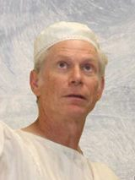
This secret will be solved through:
Understanding exactly what happened after the flood (from Shem to Abraham) and when the worship of “other gods” actually became a
strong practice among pagans.
Understanding the history of Terah and his family coming out of Ur
of the Chaldees and how they were affected by pagan gods.
Understanding that we are to follow the examples of Job and Abraham.
Understanding exactly what Moses taught through Torah about
worshipping “the created” rather than “the Creator.”
Understanding the history of both the northern tribes of Israel before
they were scattered [Part 1], and then the history of Judah from that
point onward [Part 2]. What gods were the 12 tribes mesmerized by?
What tribe has never let go of their ‘no gods’?

Slide 17
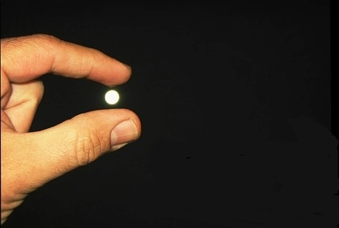
Yes, we will be picking on the moon in this study!
Out of all the “no gods” what “gods” take supremacy?
Would the sun god and the moon goddess be two supreme gods?
Out of these two, which “god” earns 1st place?

Slide 18
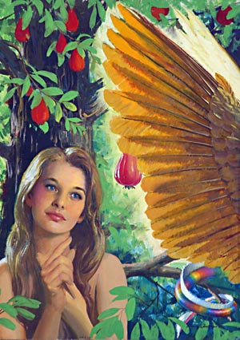
Adam, Eve and the Serpent
Satan, as fallen Lucifer, posed as one that
knew more than the Creator.
Therefore, he was posing as a “higher” god,
for the purpose of usurping worship.
The serpent was the first of every “no god.”
Assuming the two most popular choices of
“no gods” are the sun god and moon goddess, which one would Satan most likely be representing in the garden?
Romans 1:25
Who changed the truth of Yahuah into a lie, and
worshipped and served the creature more than the Creator.

Slide 19


Calendar of
Part 1: From Creation to 700 BC
History from
Adam to Hezekiah
Keeping the events in order of date
is very important for this study.

Slide 20

Patriarchs, Prophets & Kings of Yahuah
4000 | 3850 | 3550 | 3000 | 2550 | 2350 | 2000 | 1500 | 1000 | 500
Adam; Creation
130 Yrs
Enoch; “Seed” of Cain; 2nd from Adam
622 Yrs
Enoch; “Seed” of Seth; 7th from Adam
687 Yrs
Methuselah
1056 Yrs
Noah; Flood Event
2000 Yrs
Abraham; Covenant
2550 Yrs
Moses; Exodus
3000 Yrs
Solomon
3300 Yrs
Hezekiah
Will the Men of Yahuah stay true to their Creator and the Covenant Calendar that was given to Adam?
Next: Let’s check out some genealogies and see if there
was a reliable line of communication between generations.

Slide 21
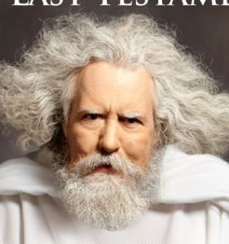
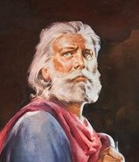
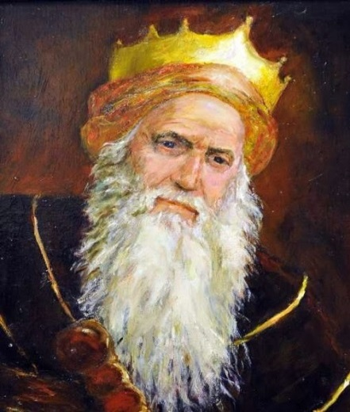
Great Men of Yahuah from 4000 to 2000 BC
Adam
930 Years
4004-3074 BC
Enoch
(line of Seth)
365 Years
3382-3017 BC
Noah
950 Years
2948-1998 BC
Adam would have
taught the Creation
Calendar to the next
8 generations before
Noah is asked to carry
this torch of truth.
This great man was
chosen to teach the truths handed down from Adam to the next 10 generations including Abraham.
Adam was about
600-900 years old
during the lifetime
of Enoch.

Slide 22
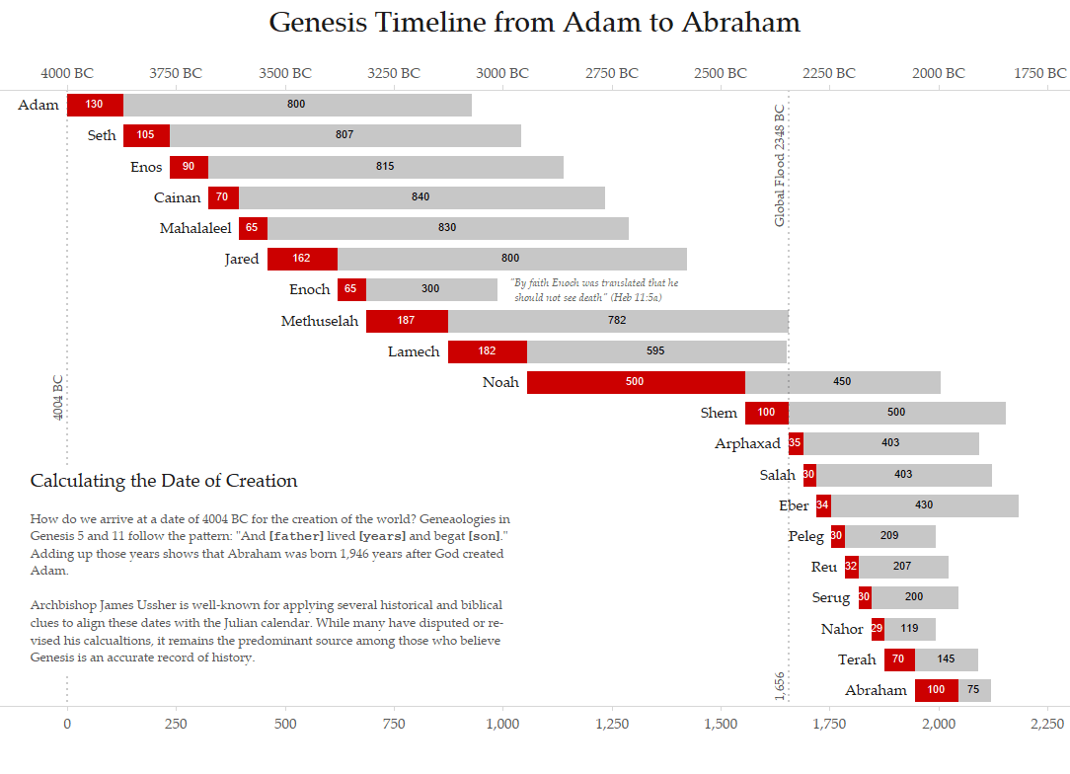
Adam
Adam had the privilege and responsibility to instruct 8 generations after him to Lamech for almost 1000 years.
He would have also honored, taught and preserved Yahuah’s Covenant Calendar.
Luke 3:38
… Adam, which was the
son of Yahuah.

Slide 23

Enoch
Enoch would have easily known Adam
all his life, being instructed in Yahuah’s Covenant, including the Divine Calendar. He never met death on earth.
Do you think he would have been translated if he was living in disobedience
to the Covenant Calendar?
Gen 5:24
And Enoch walked with Yahuah: and he was not;
for Yahuah took him.

Slide 24
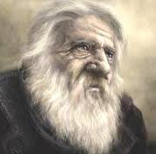
Methuselah
3317-2348 BC
Methuselah lived 669 years after
his father Enoch was translated. He was a witness to 11 generations - more than anyone
in the world. Being instructed for 300 years by Enoch, with the Covenant truths confirmed in Adam and all previous generations, Methuselah is an invaluable link by preserving every truth
for future generations.
Gen 5:22
And Enoch walked with Yahuah after he begat Methuselah three hundred years.

Slide 25
Noah
Gen 6:8-9
8 Noah found grace in
the eyes of Yahuah.
9 … Noah was a just man
and perfect in his generations,
and Noah walked with Yahuah.
Gen 7:5 And Noah did according unto
all that Yahuah commanded him.
2 Peter 2:5 Noah, a preacher of righteousness …
Noah was able to have instruction from 6 generations before
him that knew Adam and learned from his lips. Noah, as the great connecting link, would have handed down these instructions to the following 10 generations all the way to Abraham.
He documented and honored Yahuah’s Covenant Calendar!

Slide 26
Dates of Biblical Events from Creation
Event/Person | Passage | Time from Creation
Creation in the beginning. | Gen 1–2 | 0
Adam became the father of Seth at 130. | Gen 5:3 | 0 + 130 = 130 yrs.
Seth became the father of Enosh at 105. | Gen 5:6 | 130 + 105 = 235 yrs.
Enosh became the father of Kenan at 90. | Gen 5:9 | 235 + 90 = 325 yrs.
Cainan became the father of Mahalalel at 70. | Gen 5:12 | 325 + 70 = 395 yrs.
Mahalalel became the father of Jared at 65. | Gen 5:15 | 395 + 65 = 460 yrs.
Jared became the father of Enoch at 162. | Gen 5:18 | 460 + 162 = 622 yrs.
Enoch became the father of Methuselah at 65. | Gen 5:21 | 622 + 65 = 687 yrs.
Methuselah became the father of Lamech at 187. | Gen 5:25 | 687 + 187 = 874 yrs.
Lamech became the father of Noah at 182. | Gen 5:28 | 874 + 182 = 1056 yrs.
The Flood started when Noah was 600. | Gen 7:6 | 1056 + 600 = 1656 yrs.
Notes:
From: https://answersingenesis.org/bible-timeline/timeline-for-the-flood/

Slide 27
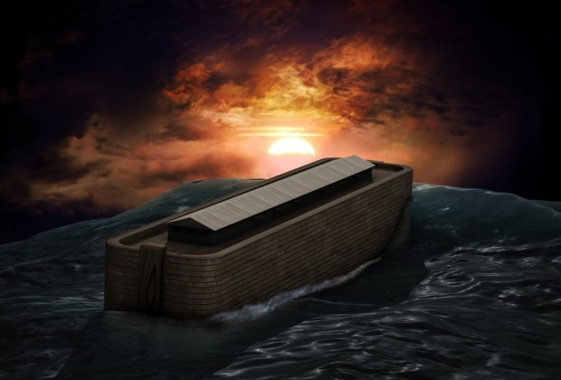
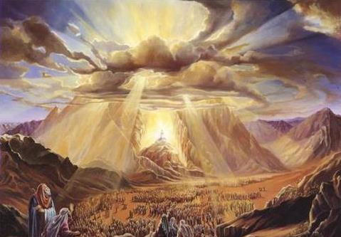
Noah Establishes the
month length
of the Covenant Calendar
in the Flood Account
The Torah proves from the Flood to Mt Sinai the
Creation Months were
30 days per month for the first 1656 Years!

Slide 28
Noah & the Flood – 30 Day Months
The Genesis Account
(1656 Years From Creation)
Do the Math
(30 days/month)
Gen 7:11, 24 In the six hundredth year of Noah's life, in the second month, the seventeenth day of the month, the same day were all the fountains of the great deep broken up, and the windows of heaven were opened.
24 And the waters prevailed upon the earth an hundred and fifty days.
Gen 8:3-4 And the waters returned from off the earth continually: and after the end of the hundred and fifty days the waters were abated.
4 And the ark rested in the seventh month, on the seventeenth day of the month,
upon the mountains of Ararat. KJV
  2nd month & 16th day
  + 150 days
  = 7th month & 16th day
  The NEXT day (151st) the ark came
  to rest on the 7th month & 17th day.
~2345 BC

Slide 29
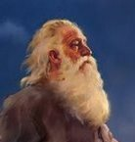
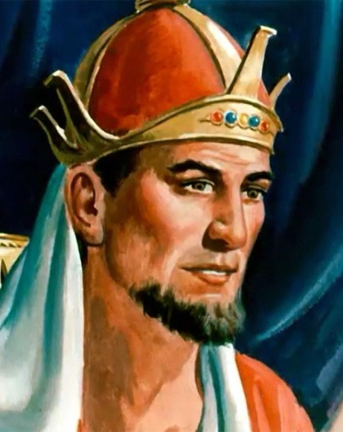

Great Men of Yahuah from 2000 to 1000 BC
Noah
950 Years
2948-1998 BC
Abraham
175 Years
1996-1859 BC
Knowing Seth for 150 years,
Abraham would have lived with the
preserved Calendar teachings of Noah.
Do you think he would have heard & learned
the Torah truths of Adam as given to Noah?
What about the truth of the Covenant Calendar?
Solomon
78 Years
1000- 922 BC
2 Chron 8:13
He started out ruling according to
the commandments given by Moses.
Moses - 120 Years
1571-1451 BC
Exodus 24
The 1st man to record
Yahuah’s Covenant in a Book.

Slide 30
Abraham
Notice the interesting connection that Abraham has all the way back to Adam for around 2200 years. Abraham was given the promise that his seed would be delivered from bondage in 430 years. Noah knows Abram for ~50-75 years!
Shem outlives Abram & knows Isaac ~110 years & Jacob ~50 years. (Isaac lived to 180 years).
Gen 26:5
Abraham obeyed
my voice, and
kept my charge,
my commandments,
my statutes,
and my laws.
Isaac Born

Slide 31
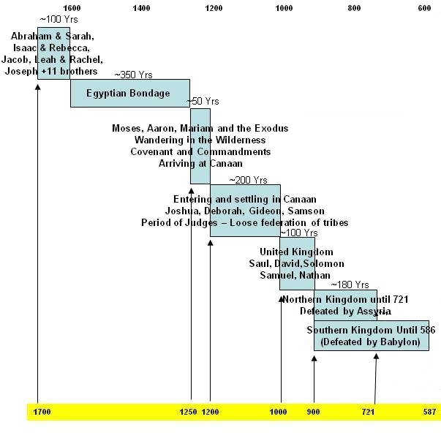
Remember:
The Book of the Covenant
written by Moses,
was re-written by
Yahuah’s finger
on stone tablets.
Moses
Moses was chosen to deliver Abraham’s seed
from bondage around 1491 BC.
The generations that have faithfully handed down Yahuah’s covenant (orally) have all faded by now.
In Exodus 19-24, Moses is instructed to record
Yahuah’s spoken Covenant from Mt Sinai in a Book.
This is now 2500 years after creation.
This full covenant also included the proper calculations
for Yahuah’s calendar in chapters 3-20 of Exodus.
Deut 34:10
And there arose not a prophet since in Israel like unto Moses, whom
Yahuah knew
face to face.

Slide 32
Covenant Calendar Preserved With the Great Patriarchs of Yahuah
Adam
930 Years
4004-3074 BC
930 Years from
Creation
Adam, the son of our Creator, would have taught the Creation Covenant Calendar:
a) 30 day months
b) 12 months in a year
to honour Yahuah at His
appointed worship times.
REV
I
EW
Enoch
(line of Seth)
(7th from Adam)
365 Years
3382-3017 BC
987 Years from
Creation
Enoch, a man so righteous he was translated,
would have taught Yahuah’s Covenant Calendar as handed down from Adam
over 600 years by this time.

Slide 33
Covenant Calendar Preserved With the Great Patriarchs of Yahuah
Noah
950 Years
2948-aaa1998 BC
2006 Years from
Creation
For the first 2000 years from creation,
Noah accurately recorded the
Covenant Calendar through the flood account.
The months still had 30 days.
He does not record the year
changed from 360 days per year!
REV
I
EW
Noah could have known
Abraham for ~50-75 years.
Shem outlived Abraham’s 175 years.
Do you think Noah or Shem would
have deviated from Adam’s Torah truths
about the Covenant Calendar?
Abraham
175 Years
1996-1859 BC
2145 Years from
Creation

Slide 34

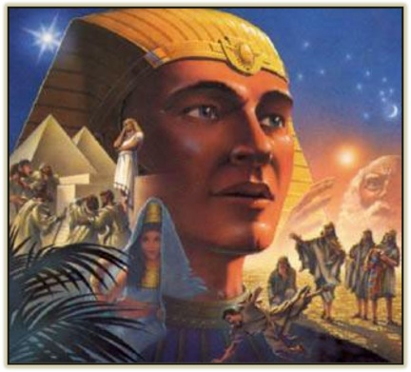
The Elohim of Joseph
1700 BC
Psalm 81:3-5
3 Blow up the trumpet in the new month
[H2320/chodesh], in the time appointed,
on our solemn feast day.
4 For this was a statute for Israel,
and a law of the Elohim of Jacob.
5 This he ordained in Joseph for a testimony,
when he went out through the land of Egypt.
Joseph Preserved the
Covenant Calendar
Until Moses

Slide 35
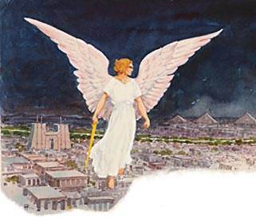
The Greatest Patriarch of Yahuah
Preserves the Covenant Calendar in Writing
Moses
120 Years
1571-1451 BC
~2550 Years from
Creation
Moses was the first patriarch to record
Yahuah’s Covenant Calendar in the Torah.
Up to that time, information was
handed down orally from Adam onward.
REV
I
EW
Yahuah’s
Covenant Calendar
kept & preserved
from Passover
to Mt Sinai.

Slide 36

were preserved by the patriarchs and prophets for 2550 years.
How did the ‘no gods’
enter the picture?

Slide 37
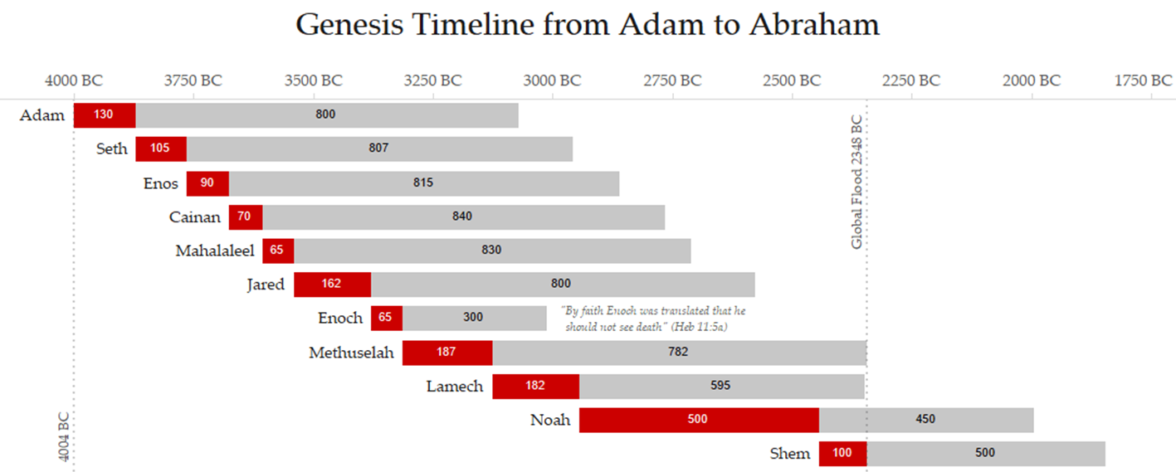
Adam to Noah – worship of other gods?
Adam: 930
Seth: 921
Enos: 905
Cainan: 910
Mahalaleel: 895
Jared: 962
Enoch: 365+
Methuselah: 969
Lamech: 777
Noah: 950
Noah
Adam
Adam had the privilege and responsibility to instruct 8 generations after him to Lamech for almost 1000 years.
He would have cautioned as many as possible to stay away from other ‘gods.’
Thought to Ponder:
There is no record in Genesis 1-6 of these righteous patriarchs serving other gods!
Where did the worship of other gods begin?

Slide 38
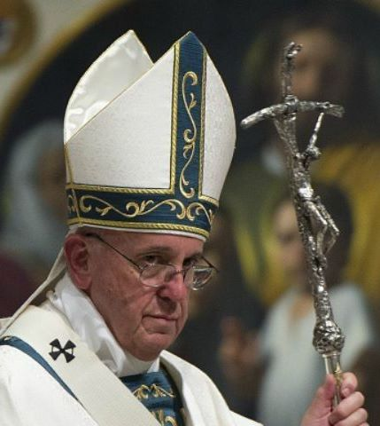
“no gods” Before the Flood
Today there are 1000s of “no gods,” but this wasn’t always so.
Before the flood, it is now believed pagan gods were first actually
mortal men. They were born, waged war, had children, and died, whereupon they were deified as gods by their descendants. This is
not wild speculation. On the contrary, this is a position taken by nearly
all historians of antiquity including: Isaac Newton; Augustine of Hippo; Eusebius; Justin Martyr; Josephus, etc.
It was commonly believed that if a man was good enough,
he could become a god too. This carried on down to the
Roman Caesars including the Roman Pontiffs today.
The mythologies were real stories of real men,
embellished as gods in their afterlife.

Slide 39
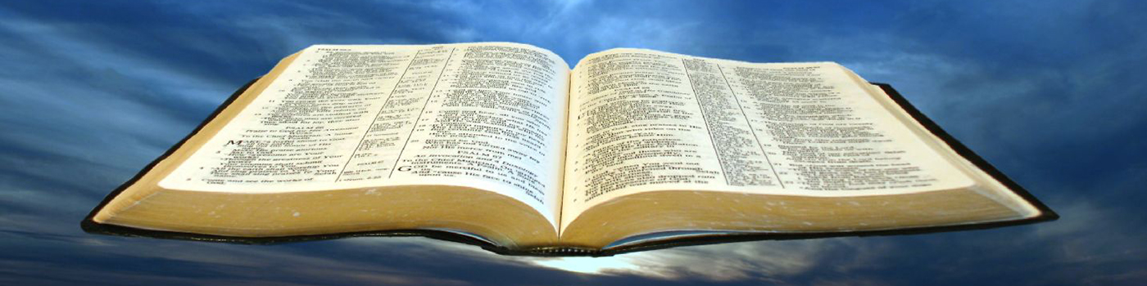
Humans Worshipped as Pagan “gods”
Augustine (~400 AD wrote): “… those deities who are reckoned gods of the higher orders have gone from us into heaven. Ask whose sepulchres are pointed out in Greece.”
To simplify it, the pagan gods of the higher order were simply men; their graves in Greece.
They started life as men and were deified and “dressed up” by those who survived them.
This was a pagan practice common enough to be captured in the pages of Scripture:
Acts 12:21-23 “On the appointed day Herod, wearing his royal robes, sat on his throne and delivered a public address to the people. They shouted, ‘This is the voice of
a god, not of a man.’ Immediately, because Herod did not give praise to Yahuah, an angel of Elohim struck him down, and
he was eaten by worms and died.” (NIV)
Hebrew heroes
were not deified.

Slide 40
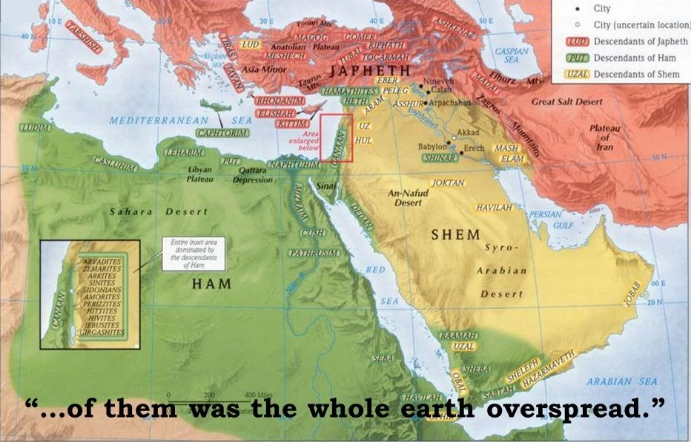
Gen 7-9 ~2350 BC - After the Flood
Gen 7-9 | ~2350 BC | Only 8 people were saved at the time of the flood.
Noah’s families grew and became dispersed/estranged from one another in the land
of Ur of the Chaldees.
Ham’s choices: When men
turned away in their supposed wisdom from the true knowledge
of their Creator, the inevitable
result was idolatry and heathenism, thus changing the glory of Yahuah into images like man, birds, beasts and creeping things (Rom 1:23).
Yahuah had to separate a people for Himself from this next rising heathen kingdom from Ham’s descendants.
Shem choices: preserved the pure knowledge and worship of Yahuah down to his descendants
of Terah and sons Haran, Abram and Nahor.
Note: All dates are approximate calculations.

Slide 41
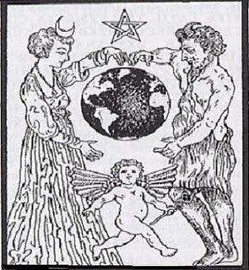
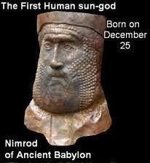
Gen 10:8-9 ~2250 BC – Nimrod/Babel
Gen 10: vs 8-9 | ~2250 BC | “And Cush begat Nimrod: he began to be a mighty one in the earth. 9 He was a mighty hunter before Yahuah.”
When Nimrod died, he was the first human that became deified as the “sun god” eventually named Baal. His wife, Semiramis, became the “moon goddess” [also named Ashtoreth]. Tammuz, the illegitimate son, became the
“false messiah.”
These are the 3 main false deities of the Scriptures.
Many new languages confused the construction on the
Tower of Babel. Therefore, the “sun god,” “moon goddess”
and Tammuz were given many new names with each culture.
The entire earth is lying in the power of ancient Babylon and the spell cast by these religious ideas that originally started with Nimrod, Semiramis and Tammuz.

Slide 42
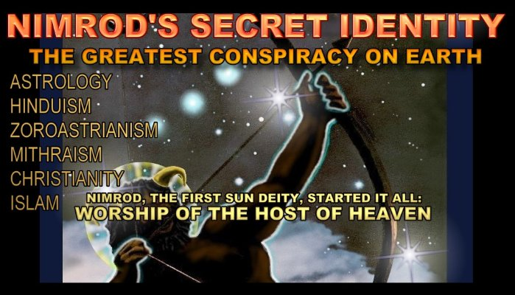
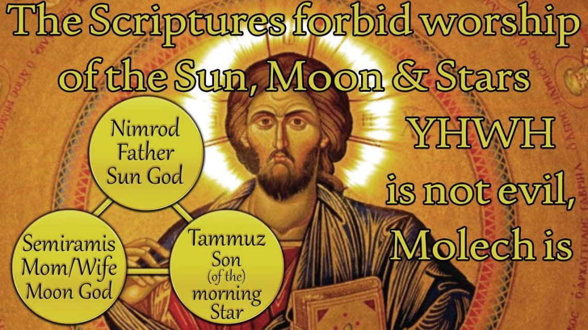
The Tower of Babel: 700 yrs after the flood …
This was only the beginning!
this
Includes sacred regard!

Slide 43
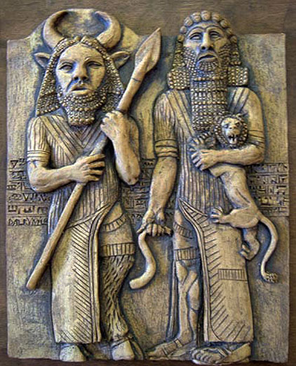
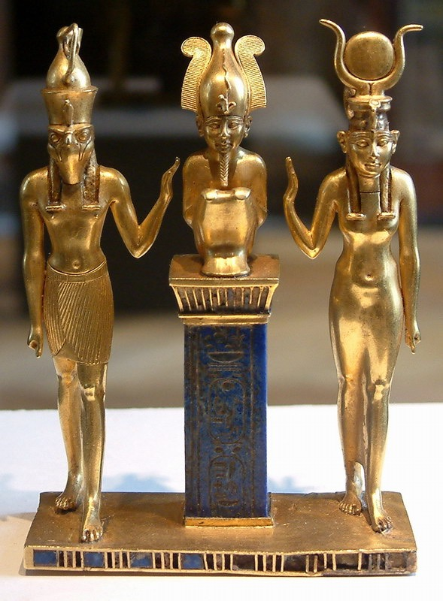
Names of “no gods”
The Scriptural history of pagan gods
begins with Nimrod, the sun god.
Culture | Nimrod Lord of Heaven | Semiramis Queen of Heaven | Son False Messiah
Israelites | Baal | Ashtoreth | Tammuz
Phoenicians | El | Astarte | Bacchus
Babylon | Belus | Rhea, Ishtar | Tammuz
Assyria | Ninus | Beltis | Hercules
Greece | Zeus | Aphrodite | Dionysius
Rome | Jupiter | Cybele, Diana | Attis
Egypt | Ra | Isis, Hathor | Osiris, Horus

Slide 44
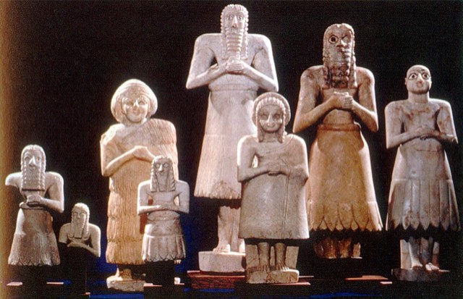
Gen 11 ~1925 BC – Terah’s Family
Even though the family of Shem, through Terah, had a knowledge of the proper worship of Yahuah, their worship was also corrupted by idolatry,
serving other gods in Ur of the Chaldees.
Gen 11:31 Terah took Abram, Lot and Sarai “… and they went forth with them from Ur of the Chaldees …”
Josh 24:2 And Joshua said unto all the people,
Thus saith Yahuah your Elohim of Israel,
Your fathers dwelt on the other side of
the flood in old time, even Terah, the
father of Abraham, and the father of
Nachor: and they served other gods.
Other “gods” of Ur

Slide 45
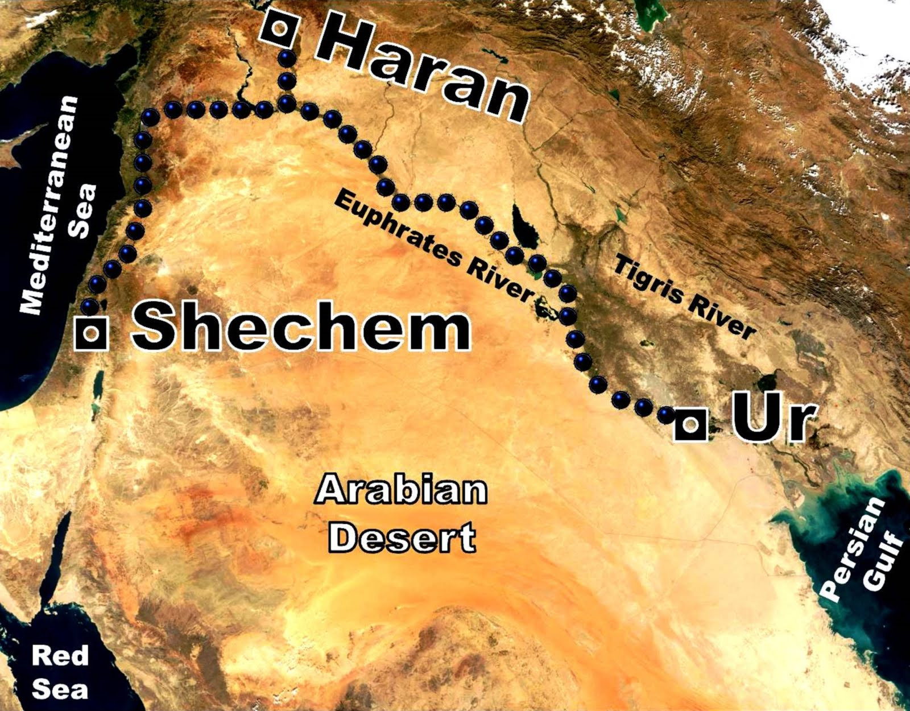
Gen 11:31 | ~1925 BC | And Terah took Abram his son, and Lot the son of Haran his son's son, and Sarai his daughter in law, his son Abram's wife; and they went forth with them from Ur of the Chaldees, to go into the land of Canaan; and they came unto Haran, and dwelt there.
Yahuah needed to separate out
“a people” [Terah’s family] for Himself that would not serve “other gods.”
They eventually settled in Haran.
Haran was a leading settlement with a temple dedicated to moon worship!
Abram was “called out of Haran” to Canaan. He continued to be righteous and faithful never turning to pagan worship.

Slide 46
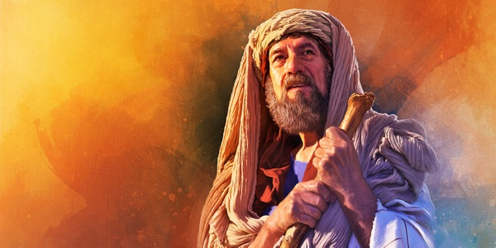
Terah Remains in Haran
Terah did not proceed beyond Haran, feeling this was “his” land of Canaan.
Terah (H8646; Terach) had a family business of manufacturing idols.
The main “no gods” of Ur were the “sun god” and “moon goddess.”
What kind of gods may Terah
have been involved with?
Josh 24:2 declares Terah (and family) served other gods. Out of Ur this would have been gods fashioned after Nimrod and Semiramis.
Note: Abraham left for Canaan. Laban didn’t!

Slide 47

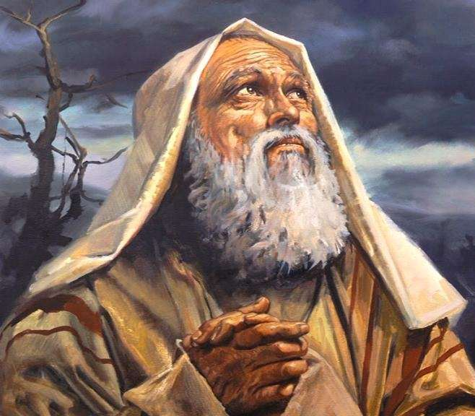
Abram Searches out Canaan (Gen 12:1-4)
It was in Haran (at Terah’s death) that Abram received the divine call to continue to Canaan (Gen 12:1-4).
Question: Was Abram an idolater before his call?
Although Abram was not entirely free from the influence of idolatry in his father’s house, there
is no indication in the Scriptures that idol worship
was part of his life.
Gen 26:5 Abraham obeyed my voice,
and kept my charge, my commandments,
my statutes, and my laws.
This may be the reason why Abram was
“called out” to Canaan. Lot went with him.
What about the rest of Terah’s family … Nahor?

Slide 48
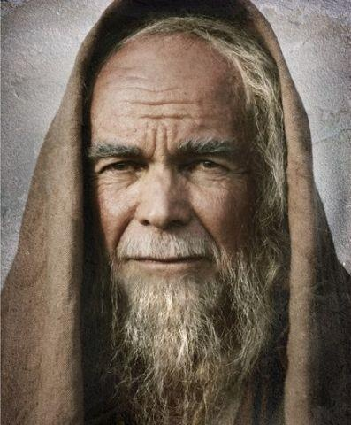
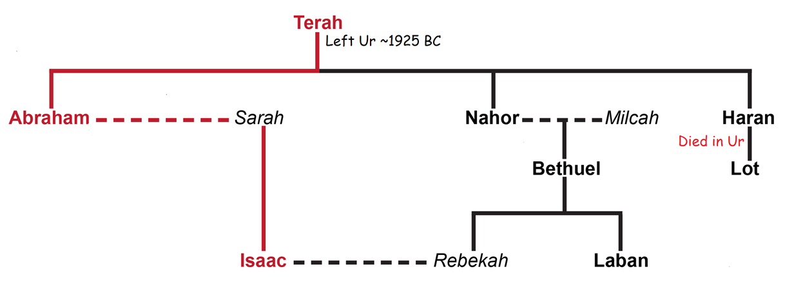
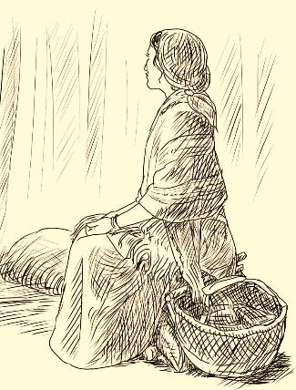
Nahor & Laban Remain in Haran
Laban was born about 1890 BC.
Images and idols were still in Terah’s [H8646] family 200 years later.
About 1740 BC Rachel stole Laban’s images (Gen 31:19).
images H8655; teraphim; a family idol.
It’s time to make the connection between:
“teraphim” images and Great-grandfather “Terah”!

Slide 49

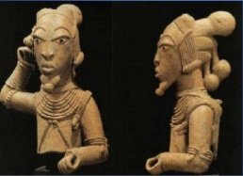
Commentary for “Terah” and “teraphim”
Gen 31:25-35 “Why hast thou stolen my gods?”
(The Wycliffe Bible Commentary) Here he [Laban] referred to his (teraphim) (v. 30; cf. 19).
Evidently Laban was more concerned over losing his images than over losing Jacob's family.
His search failed to discover these little "gods."
(Barnes' Notes) Teraphim; (OT:8655). This word occurs three
times in this chapter, and nowhere else in the Pentateuch.
It is always in the plural number.
The teraphim were symbols or representatives of the Deity,
as Laban calls them his gods. They seem to have been busts
of the human form, sometimes as large as life (1 Sam 19:13).
Those of full size were probably of wood; the smaller ones may
have been of metal. They have been worn on an ephod for the purposes of divination
(Gen. 30:27). The employment of them in the worship of God, which Laban seems to have inherited from his fathers (Josh 24:2), is denounced as idolatry (1 Sam 15:23); and hence, they
are classed with the idols and other abominations [eventually] put away by Josiah (2 Kings 23:24).

Slide 50

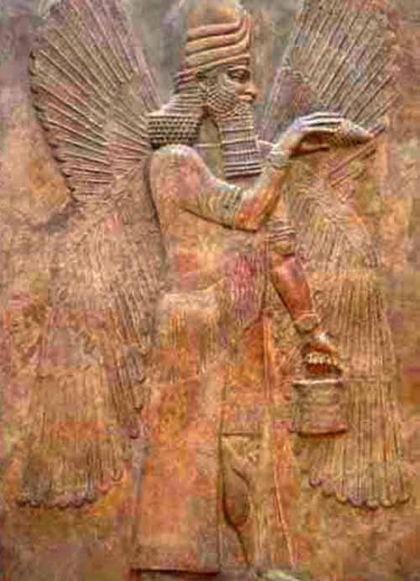
Which “no god” gains the authority?
… the sun god?

Slide 51
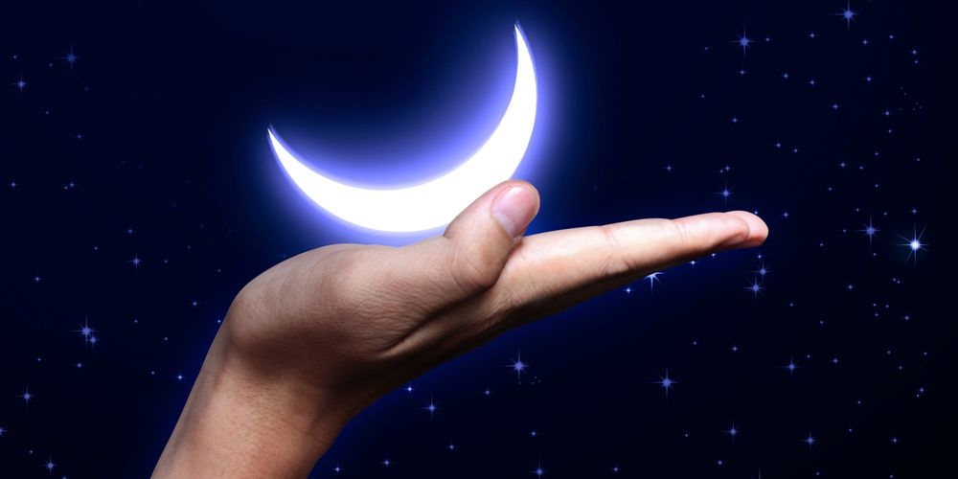
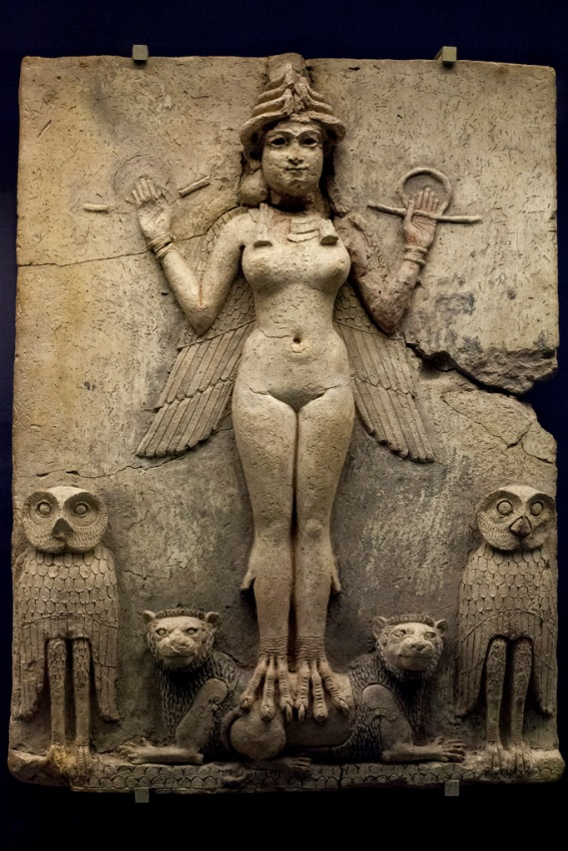
… or the moon goddess?
Semiramis
Let’s begin by examining “Laban.”

Slide 52


Investigation on the Hebrew Name
Laban
Gen 31:30, 34 And [Laban said], yet wherefore hast thou stolen
my gods?
34 Now Rachel had taken the images … and sat upon them.
And Laban searched all the tent, but found them not.
Notes:
Ancient idolatry (teraphim [household idols]: Idolatry originally meant the worship of idols, or the worship of false gods by means of idols, but came to mean among the Old Testament Hebrews any worship of false gods, whether by images or otherwise, and finally the worship of Yahuah through visible symbols (Hos 8:5, 6; 10:5).
In the New Testament, idolatry not only meant the giving to any creature or human creation the honor or devotion which belonged to Yahuah alone, but the giving to any human desire a precedence over Yahuah’s will (1 Cor 10:24; Gal 4:20; Col 3:5; 1 Pet 4:3).

Slide 53
Comparing “Terah & Images” to “Laban & the Moon”
Column 1 + | Column 2 = | Column 3
Terah (H8646) | “teraphim” Images (H8655) “Family Idols” | Spelling, Pronunciation and Word Numbers Connect to Idols
Laban (H3837) | “lebanah” (H3842) “Whiteness” (color of the moon) | Spelling, Pronunciation and Word Numbers Connect to the Moon
There is very strong indication now that Terah did have an occupation in Haran of making [moon] idols for distribution.
Remember, Terah came out of Ur, the first center for major idol worship and Haran was also a moon worshipping center.
There is no Scripture stating those words, but the connection can be proven through the name Terah, and the “teraphim” family idols that
were in Laban's possession nearly 200 years later – only to be coveted
and stolen by Rachel.

Slide 54



The Family Business of Terah
Column 1 + | Column 2 = | Column 3
Terah (H8646) | “teraphim” Images (H8655) “Family Idols” | Spelling, Pronunciation and Word Numbers Connect to Idols
Laban (H3837) | “lebanah” (H3842) “Whiteness” (color of the moon) | Spelling, Pronunciation and Word Numbers Connect to the Moon
Terah’s business of manufacturing idols
would have been passed down through the generations, thus a line of precious family idols.
Everything is pointing back to these “family
idols” as being connected to moon worship (Laban/Lebanah). These were moon idols –
linked to Semiramis in Babylon.

Slide 55

Egypt & Moon Worship
Abraham was told his descendants would be in bondage to Egypt, not returning to Canaan for 430 years.
Egypt had “Ra” as their sun god and
“Isis” as their moon goddess.
It’s very likely these two major gods were a snare to Yahuah’s people while in bondage.
Egypt’s sun god “Ra” was challenged by the 10th plague of Egypt resulting in the death of the first born of each family.
At Passover, all firstborn “under the blood” were delivered from death.
There are 42 campsites on the journey to Canaan. Let’s examine Campsite #11.

Slide 56

~1490 BC Mt Sinai: 11th Campsite
The #11 connects to negative concepts of reproof, warning and disorder.
The root word for “Sinai” means “tares, thorns and demons” [neg. form].
In the Syric language, “Sinai” means “to shine” as the “moon” which was an object of worship in the area.
This campsite, found in an area of moon worship, is the very place where the enemy planned to again exalt his throne over Yahuah’s.
Only 40 days after the everlasting covenant was spoken, Yahuah’s people had broken their covenant agreement, and were found dancing before the image of the Egyptian false trinity.
This action was clearly a case of blasphemously mixing worship intended for Yahuah as well as being mixed with idolatry.
Notes:
Sept 14 p 4 Sinai [N] [H]of Sin (the moon god), called also Horeb … http://www.biblestudytools.com/dictionary/sinai/
http://www.jewishencyclopedia.com/articles/13766-sinai-mount
"Sinai" is derived from the name of the Babylonian moon-god Sin.

Slide 57

11th Campsite: False Trinity
Exo 32:4-5 … he [Aaron] had made it a molten calf: and they said, These be thy gods, O Israel, which brought thee up out of the land of Egypt.
5 And when Aaron saw it, he built an altar before it …
The golden calf was not a single entity. There were three “gods” represented in Aaron’s design at the base of Mt Sinai.
The physical altar site still stands at the base of Jebel el Lawz along with photos of what the Egyptian calf “god” most accurately looked like.

Slide 58



Egypt’s Unholy Trinity
The golden Egyptian “calf god” does NOT depict a “single god.”
The solar disk represents the serpent/sun “god,”
as the “father” of the calf “god,” shown on the
head of the golden calf.
The 3rd deity is the female component.
It is not part of the golden calf itself,
but rather was part of the altar base.
Upon the stones are petroglyphs
depicting this Egyptian “god.”
These deities were also known as the
“sun god,” with the “moon goddess” being
his wife. Their son was the false messiah.
(Called to Canaan, Bk 1, Chapter 11, Davis & Manfredine.)
In this
image
2 gods
are
seen.
Extra information on the golden calf on the last slide – from Beth Holtwick Mar 2019.

Slide 59

What is still standing ~3470 years later?
The “altar” representing
the moon goddess!

Slide 60

Moses’ Gives Strict Commands in
Deut 4:15-19; 17:2-5
Moses told
the people not to follow the
pagan gods.
But, he also
said, after
he dies that is
exactly what
they will do!
If there be any found among you that:
Corrupt yourselves by lifting your eyes unto heaven, seeing the sun, moon, stars and all the host of heaven …
If then you are driven to worship them, serve them,
or give them sacred regard for any reason …
That person shall be stoned until they die.
For Yahuah hath commanded that none should serve
or give sacred regard to other gods represented by
the sun, moon and stars.

Slide 61

Yahuah’s Calendar
The pagans began their days with looking to the sun.
They also began their months by looking to the moon.
Yahuah’s calendar commencements do not follow the ways of the pagans
by looking to the sun or the moon for calculation of His worship times.
Therefore, there is nothing more offensive to Yahuah than the mixing of these profane, idolatrous practices with His sacred worship.
This would be the ultimate blasphemy and an act tantamount
to the highest level of spiritual rebellion – it’s an abomination!
It was these pagan roots that were found at the base of Mt Sinai only
40 days after the people had agreed to Yahuah’s everlasting Covenant!
Beware of falling into idolatry while professing to worship your Creator.

Slide 62

What About the ‘Calendar’ &
Christian Churches Today?
Sunday Christians: all honour their day of worship on
“Sunday” – giving homage to the “sun god” from ages past.
Sabbath Keepers: most honour the opening of their
worship days beginning with the sunset the
night before Sabbath, paying homage to
the “sun god” from ages past.
Sabbath Keepers/most Feast Keepers:
In addition to honouring sunset,
most also honour the moon for
the Biblical month-start, thus
paying homage to the “goddess
of the moon.”
Which of the 3 groups is most deceived?

Slide 63



~1450 BC Joshua Follows Moses’ Leadership
Joshua’s 1st campaign before entering the land of Canaan was to destroy Jericho [Yericho], a MOON worshipping city.
~1430 BC: For 20 years he fought to rid the land of Canaan of pagan people and practices.
Before Joshua died, he gave them strict warnings NOT to run after and serve other gods.
The people promised to be obedient …
But, the pagan gods were still a problem!
Joshua said
“Shout!
The walls
will come
down!”
~1425 BC: Josh 24:22-23 appeal is given. “Joshua said unto the people,
Ye are witnesses against yourselves that ye have chosen you Yahuah, to serve him. And they said, We are witnesses. 23 Now therefore put away, said he, the strange gods which are among you, and incline your heart unto Yahuah the Elohim of Israel.”
So Israel still had “strange gods” among them?

Slide 64

Joshua’s Pillar at Shechem
Josh 24:24-27 And the people said unto Joshua, Yahuah our Elohim will we serve, and his voice will we obey.
25 So Joshua made a covenant with the people that day, and set them a statute and an ordinance in Shechem.
26 And Joshua wrote these words in the book of the law of Yahuah, and took a great stone, and set it up there under an oak, that was by the sanctuary of Yahuah.
27 And Joshua said unto all the people, Behold, this stone shall be a witness unto us; for it hath heard all the words of Yahuah which he spake unto us: it shall be therefore a witness unto you, lest ye deny your Elohim.
Some archeologists believe this could be the stone Joshua erected at Shechem to hear and bear witness to Yahuah’s covenant with Israel.
Sacred Stone at Shechem
64

Slide 65

Shechem – Place of Decision for Yahuah
Gen 12:6-7 Abram built an altar to Yahuah at Shechem;
the everlasting covenant was confirmed with him there.
Gen 33:18-20 Jacob’s altar was at Shechem, his 1st dwelling place
in Canaan.
Gen 35:4 Jacob hides the family idols under the oak tree at Shechem.
Josh 24:32 Joseph’s tomb is at Shechem.
Josh 24:1-15 Joshua assembled Israel at Shechem to choose the “Elohim” they are planning to serve.
Josh 24:14-15 Now therefore fear Yahuah… and put away the gods which your fathers served on the other side of the flood, and in Egypt … 15 … choose you this day whom ye will serve; whether the gods which
your fathers served that were on the other side of the flood,
or the gods of the Amorites, in whose land ye dwell:
but as for me and my house, we will serve Yahuah …
Josh 24:25 Shechem was the place where Joshua renewed the covenant with the people just
before he died.

Slide 66


History from Judges to Malachi
The history of the apostasy in the Old Testament magnifies considerably after Moses dies.
Beginning with Judges is where
the Scriptures FIRST mention
Baal and Ashtoreth.
Common Terms in the
Old Testament:
Baal = sun god
(or Baalim, plural)
Ashtoreth = moon goddess
Will one
of these
pagan gods
be dominant?

Slide 67
“Idol” Definitions for this Study
Name | Definition
Baal | The chief male deity of the Phoenicians and Canaanites; Ashtoreth was their principle female deity. The worship of Baal, together with that of Astarte, was common among the Hebrews. Human sacrifices were also offered to Baal by the Jews (Jer 19:5).
Ashtoreth Ashtaroth | A Syrian goddess/idol whose worship was very ancient and common among the Israelites. She is generally mentioned in connection with Baal, and is commonly identified with Astarte, the goddess of the moon.
Queen of Heaven | The moon was called the “queen of heaven.” There are 3 rebukes from Jeremiah to Judah for this abomination (Jer 7:18; 44:7-19, 25).

Slide 68


Name | Definition
Groves | “Tree image(s)” for worship of the goddess Ashtaroth. It was forbidden by Yahuah for “groves” to be established for worship. (11 references in the Old Testament for Israel’s worship in the groves.)
 | Isa 40:20 He that is so impoverished that he hath no oblation chooseth a tree that will not rot; he seeketh unto him a cunning workman to prepare a graven image, that shall not be moved. 2 Kings 17:16 And they left all the commandments of Yahuah their Elohim, and made them molten images, even two calves, and made a grove, and worshipped all the host of heaven, and served Baal.
High Places | A term used to describe places of worship for Yahuah in groves (13 in OT); idolatrous worship (9 in OT); idolatrous high places to be destroyed (5 in OT).
68

Slide 69


Name | Definition
Chiun | An idol made and worshipped by the Israelites in the wilderness.
Molech Moloch Milcom | An idol of the Ammonites; worshipped by Solomon and his wives. Israel sacrificed their children to Molech’s molten arms (12 in OT).
 | Jer 7:31 And they have built the high places of Tophet … to burn their sons and their daughters in the fire; which I commanded them not, neither came it into my heart.

Slide 70

[Some] Names … | … of Scripture … | … Pagan Gods.
1. Adrammelech [sun ] | 11. Castor/Pollux | 21. Nebo
2. Anammelech [moon] | Chemosh | 22. Nehushtan
3. Ashima | 13. Chiun | 23. Nergal
4. Ashtoreth [moon goddess] | 14. Dagon [sun god] | 24. Nibhaz
5. Baal [sun god] | 15. Diana [moon goddess] | 25. Nisroch
6. Baal-berith | 16. Golden Calf [trinity] | 26. Queen of heaven [moon]
7. Baal-peor | 17. Jupiter | 27. Rimmon
8. Baalzebub | Mercury | 28. Succoth-Benoth
9. Baal-zephon | 19. Molech or Milcom | 29. Tammuz [also a sun god]
10. Bel [sun god] | 20. Merodach | 30. Tartak
Please
note
one
more
def.:
Haran: A city of the main trade routes between Babylonia and
the Mediterranean Sea. Like the Chaldeans, Haran's inhabitants worshipped Sin [Ciyn (seen)], the moon-god from very ancient times.
It was a natural stopping place for Terah to settle on his departure from Ur. The cult of moon worship persisted far into the Christian era after the 4th century AD.

Slide 71

Abundance of Pagan Worship
For the listed phrases there are at least 887
Old Testament references linking to pagan worship.
# in OT | Phrase | # in OT | Phrase
140 | Image/Images | 80 | High Places (moon worship)
46 | Graven Image(s) | 3 | High Places of Baal
23 | Molten Image(s) | 2 | Priest of Baal
5 | Carved Image(s) | 4 | Sun, moon and host of heaven
2 | Images of Baal | 14 | Host of heaven
95 | Idol(s) | 220 | gods (pagan)
62 | Baal | 6 | no gods
18 | Baalim | 10 | thy gods
5 | Queen of Heaven | 34 | their gods
3 | Ashtoreth (moon goddess) | 52 | Altars
10 | Molech/Moloch/Chuin | 12 | Burnt their children in fire
41 | Grove(s) (moon worship) | 887 | References to pagan worship/practices
OT history books = 549 chapters!
Average mention of apostasy = 15 times in every 10 chapters!
Notes:
Calculation: OT Chapters = 989 …
Number of chapters in Torah (197) + chapters from poetry books [Job, Ps, Prov, Eccl, S of Songs] (243) = 440 chapters
Total OT chapters = 989. Minus 440 chapters = 549 chapters left for the books of history and prophecy.
Number of chapters for only the historical books from Joshua to Malachi = 549
Number of times pagan worship is mentioned in the historical/prophetic books: 549 chapters [divided by] 887 mentions of apostasy = 1.6 times/chapter …
OR: 15 mentions about paganism in every 10 chapters.

Slide 72

The Snares of the “no gods”
Right from the Garden of
Eden, where “another god”
was honoured, the whole
Old Testament history is
tainted with roots that
link to paganism.
Israel (and all pagan nations) worshipped many, many gods. Was every pagan god a snare to Israel, or was something else going on in the background?

Slide 73

The Snares of Baal & Ashtoreth
This study will show the many times Israel and Judah fell back into apostasy.
The main gods that were a snare to Israel that keep coming to the forefront are:
1) the sun god (Baal/Baalim) and 2) the moon goddess (Ashtoreth).
Right from Mt Sinai these are the first two gods
that Moses instructed the people NOT to worship!
Moses commanded the people to not even
think about “looking to the sun or moon” as
they would soon be enticed to worship these
creations like the pagans do (Deut 4:19; 17:3).
Do not
“lift up thine eyes”!
Lift H5375 nasa'; exalt, hold up, magnify, respect.

Slide 74


“Worship” Needs Clarity
Moses was right! It will become clear, and very obvious, very quickly … that Israel and Judah were both inflicted with this terrible ungodly desire to seek other gods, even after they were delivered so mightily by Yahuah (from Ur, Egypt & Babylon).
Sacred Regard?
Today most Feast-keepers persistently gaze
at the leadership of the moon for timing their lunar based worship calendar.
This exposes their relentless cohesion to the purposely mistranslated texts of non-Torah origin.
The foundation of this lunar based worship is extracted straight out of Babylonian paganism.
Sacred
Worship?

Slide 75



“Appreciation” Needs Clarity
There is nothing “wrong” or “evil” about taking the time to admire and appreciate any of Yahuah’s creation that is given to bless the earth and mankind. All creation is the work of His mighty hand.
Rom 1:25 is a reminder to worship and serve the Creator, not the “created.”
A visual look is not evil!

Slide 76



Job Provides Clarity
Job 31:26-28 (New Living Translation)
26 Have I looked at the sun shining in the skies,
or the moon walking down its silver pathway,
27 and been secretly enticed in my heart to worship them?
28 If so, I should be punished by the judges, for it would
mean I had denied Yahuah in heaven.
Job is talking
about this kind of “looking” …
… not this kind of amazement!

Slide 77

Who is Baal? Do we really know?
Baal, the most significant male deity of the Canaanites, along with his companion Asherah, were the most
alluring deities confronting Israel in the promised land.
Abundant references to Baal in the Old Testament
indicate his attractiveness and influence on the Israelites.
The Book of Judges chronicles the numerous times Yahuah’s people fell to the temptation of Baal worship.
Ahab and Jezebel made Baal worship the royal religion
of the northern kingdom (1 Kings 16:29-31) with a Baal temple in Samaria.
Baal, like Asherah, was also worshipped at high places (also known as “groves”) and required child sacrifices.

Slide 78


Slide 79


Baal’s Companion ~ Who is it?
Because of Israel’s incomplete
conquest of the land of Canaan,
the roots of Asherah-worship
from Semiramis survived and
plagued Israel, starting as soon
as Joshua died (Judg 2:13).
Considered as the moon-
goddess, Ashtoreth/Asherah
was often presented as a
partner of Baal, the sun-god.
(See Judg 3:7; 6:28; 10:6;
1 Sam 7:4; 12:10.)

Slide 80


The Groves of Ashtoreth/Asherah
This moon-goddess was represented by a limbless tree trunk planted in the ground.
The trunk was usually carved
into a symbolic representation
of the goddess.
Because of the association with carved trees, the places of Ashtoreth, (or Asherah worship), were commonly called “groves.”
The Hebrew family words of “Asherah” (plural, “asherim”) could refer either to the moon goddess or to a grove of trees.

Slide 81

Asherah Worship Forbidden
Yahuah, through Moses, forbade the worship of Asherah.
The Law specified that a grove of trees
was NOT to be near the altar of Yahuah (Deut 16:21).
Despite these clear instructions, Asherah-worship was a perennial problem in Israel.
As Solomon slipped into idolatry, one of the pagan deities he brought into the kingdom was Asherah, called “the goddess of the Sidonians” (1 Kings 11:5, 33).

Slide 82



Names & Symbols of Ashtoreth
Ashtoreth, Asheroth, Asherim, Athirat – all are plural forms of the moon goddess name; a goddess of the woods.
Imaged as a full-breasted earth mother, both symbols speak
to regeneration, sustenance and fruitfulness.
Groves of trees were her temples.
This goddess is
often referred
to as a tree or
a pole.
The “May Pole” is attributed to this goddess!
A modern day
Asherah Pole.

Slide 83
Ashtoreth Connection to May Poles
This goddess was the goddess of fertility and sexual lust, known as Ashtaroth or Ashtoreth (example: “And they put his weapons in the temple of Ashtaroth …”
1 Sam 31:10). Each spring, the pagans would set up phallic poles called Asherahs under trees on high hills and celebrate their fertility festival with unbridled sexual perversion. This is how the May Pole originated.
When the Israelites incorpo- rated this into their worship, God did not commend them for making it easier for the pagans to convert to Judaism; instead, He was provoked to anger:
“And Jehovah shall strike Israel as the reed waves in the water, and shall pluck up Israel from off this good land that He gave to their fathers. And [He] shall scatter them beyond the River, because they have made their Asherahs, provoking Jehovah to anger …
… And Judah did evil in the sight of Jehovah, and they provoked Him to jealousy above all their fathers did by their sins that they had sinned. And they also built for themselves high places, and pillars, and Asherahs on every high hill, and under every green tree” (1 Kings 14:15, 22-23).
In Exodus 34:13 and Deut 12:3, the Israelites were commanded
to destroy the Asherah poles.
In 2 Kings 23:13, King Josiah carried out demolition of the poles.
See website: https://japanesemythology.wordpress.com/study-notes-asherahs-pole-the-cosmic-polepillar/

Slide 84



Ashtoreth – the Moon Goddess
In Babylon the moon was a god, but after the rise of the solar theology, when the larger number of the Babylonian gods were resolved into forms of the sun-god,
their wives also became
solar, Ishtar, "the daughter
of Sin" the moon-god.
In Canaan, Ashtoreth, as distinguished
from the male Ashtar, dropped her warlike attributes and became a moon-goddess.

Slide 85


The “Queen of Heaven”
In Canaan, Baal passed into a sun-god. The goddess who stood at his side became the representative of the moon – or the pale reflection of the sun.
In about 628 BC Jeremiah refers to Asherah when he uses the title “Queen of Heaven” referring to the moon goddess (Jer 7:16-18; 44:17-19, 25).

Slide 86



Jezebel & Moon Goddess Worship
Along with Baal, Jezebel made Asherah-worship even more prevalent, with 400 prophets of Asherah on the royal payroll
(1 Kings 18:19).
Throughout history Israel & Judah were constantly tempted to worship this pagan goddess and attend her rituals.
It was this forbidden practice which finally led to Judah’s captivity and the seventy years in Babylon even though many good kings destroyed the Asherah groves.

Slide 87



Ancient & Modern Asherah Poles
Temple of Artemis Ephesia
Paul (in Ephesus) preached the gospel message when he was confronted by the Artemis’ cult. These people had no plans to abandon their goddess.
Modern Asherah poles
still pay tribute to
the moon goddess!
C3. 2000 BCE
Relief impression from the royal libation cup of King Gudea of Lagash (Sumer)

Slide 88

Stay Away from the Groves!
Yahuah absolutely detested the worship of His people to visit the tree poles in the high places and groves - paying tribute to the moon goddess!
Deut 16:21-22 Thou shalt not plant thee a grove of any trees near unto the altar of Yahuah thy Elohim … 22 Neither shalt thou set thee up any image.
1 Kings 11:5 [985 BC] Solomon went after Ashtoreth the goddess of the Zidonians, and after Milcom the abomination of the Ammonites.
1 Kings 11:33 [985 BC] They have forsaken me, and have worshipped Ashtoreth the goddess of the Zidonians, Chemosh the god of the Moabites, and Milcom the god of the children of Ammon, and have not walked in my ways, to do that which is right in mine eyes, and to keep my statutes and my judgments, as did David his father.
These groves were an abomination to Yahuah. Why?

Slide 89


The Groves & The Garden
Compare the Ashtoreth tree pole
with The Garden Tree Pole.
This is the tree pole of
Ashtoreth moon worship.
Did the abomination of worship
start here … “at the tree” ?

Slide 90

It is now time to review the Old Testament records of Israel’s sacred regard for pagan gods and what they stand for!
Baal [lord] - the sun god
Moon Goddess
Ashtoreth
Groves
High Places
of Worship

Slide 91

Yahuah Predicts Israel’s Rebellion
Deut 31:16 ~ 1451 BC
And Yahuah said unto Moses, Behold, thou shalt sleep with thy fathers; and this people will rise up, and go a whoring after the gods of the strangers of the land, whither they go to be among them, and will forsake me, and break my covenant which I have made with them.

Slide 92
Moses Foresees Israel’s Rebellion
Deut 31:27, 29 ~ 1451 BC
27 For I know thy rebellion, and thy stiff neck: behold, while
I am yet alive with you this day, ye have been rebellious against Yahuah; and how much more after my death?
29 For I know that after my death ye will utterly corrupt yourselves, and turn aside from the way which I have commanded you; and evil will befall you in the latter days; because ye will do evil in the sight of Yahuah,
to provoke him to anger through the work of your hands.

Slide 93


Other “gods” of Israel?
Apostate People of Psalm 81:8-12
8 Hear, O my people, and I will testify unto
thee: O Israel, if thou wilt hearken unto me;
9 There shall no strange god be in thee;
neither shalt thou worship any strange god.
10 I am Yahuah thy Elohim, which brought
thee out of the land of Egypt: open thy
mouth wide, and I will fill it.
11 But my people would not hearken to my
voice; and Israel would [have] none of me.
12 So I gave them up unto their own hearts'
lust: and they walked in their own
counsels.

Slide 94


Joshua’s Instructions
1425 BC
Joshua 24:14-18
14 Now therefore fear Yahuah, and serve him in sincerity and in truth: and put away the gods which your fathers served on the other side of the flood, and in Egypt; and serve ye Yahuah.
15 And if it seem evil unto you to serve Yahuah, choose you this day whom ye will serve; whether the gods which your fathers served that were on the other side of the flood,
or the gods of the Amorites, in whose land ye dwell: but as for me and my house,
we will serve Yahuah.
16 And the people answered and said, Yahuah forbid that we should forsake Him,
to serve other gods;
18 And Yahuah drave out from before us all the people, even the Amorites which
dwelt in the land: therefore will we also serve Yahuah; for he is our Elohim.

Slide 95

Forsake the Strange “gods”!
Israel’s Promise: Joshua 24:20-24
1427 BC
20 If ye forsake Yahuah, and serve strange gods,
then he will turn and do you hurt, and consume you,
after that he hath done you good.
21 And the people said unto Joshua, Nay; but we will serve Yahuah.
22 And Joshua said unto the people, Ye are witnesses against yourselves
that ye have chosen you Yahuah, to serve him.
And they said, We are witnesses.
23 Now therefore put away, said he, the strange gods which are among
you, and incline your heart unto Yahuah the Elohim of Israel.
24 And the people said unto Joshua, Yahuah our Elohim will we serve,
and his voice will we obey.
Then, about 2 years later …

Slide 96
1425 – 1250 BC Book of Judges
The following tables chart a brief review of the worship of pagan gods and apostasy in the 12 tribes.
Please take special note of the dates, as we travel through Israel’s history to 700 BC.
Ref. | Date | Description
Judg 2:3 | ~1425 BC | Israel did not drive out the pagans. They would be constantly snared by false gods.
Judg 2:11-13 1st mention | ~1425 BC | Israel served Baalim (sun god), the most important god; & Ashtoreth (moon goddess).
Judg 2:17, 19 | ~1425 BC | Israel would not hearken to judges but whored after other gods bowing down to them.
Judg 3:6, 7 | ~1405 BC | Intermarried the sons/daughters with pagan nations and served their Baalim gods.
Judg 5:8 | ~1315 BC | Israel chose new [strange] gods. [Deut 32:16]
Judg 6:10 | ~1250 BC | Yahuah cautions to not fear the gods of the Amorites.
Remember: 200 years earlier Moses had given very strict commands to Israel
so the people would be kept free from the worship of pagan gods.
Question:
Did Israel have troubles with running after the sun gods and
moon gods in the remainder of the history of the Old Testament?

Slide 97
1250 BC Gideon as Judge
Ref. | Date | Description
Judg 6:25-33 | ~1250 BC | Gideon throws down the Baal altar (sun god) that belonged to his father.
Judg 10:6 | ~1205 BC | The children of Israel did evil again in the sight of Yahuah, and served Baalim [sun god], and Ashtoreth [moon goddess], and the gods of Syria, Zidon, Moab, Ammon, and the Philistines, and forsook Yahuah, and served not him.
Judges 10:6 “The children of Israel did evil again in the sight of Yahuah.” This apostasy seems to have exceeded every former one in the grossness and universality of the idolatry practiced.
The Hebrews adopted the objects of worship among the several pagan countries bordering the district of Palestine in which they lived. Some scholars feel Israel may have actually erected a Pantheon. It’s hard to believe Israel became universal idolaters, adopting every god of the surrounding nations. Baalim and Ashtaroth signify gods and goddesses in general reckoned as:
1. The gods of Syria; Bel and Saturn, or Jupiter and Astarte
2. Gods of Zidon; Ashtoreth, Astarte or Venus
3. The gods of Moab; Chemosh
4. Gods of the children of Ammon; Milcom
5. Gods of the Philistines; Dagon.
Yahuah gave Israel up to be in bondage to the
Philistines & Ammonites.

Slide 98

1120 – 1055 BC Samuel & Saul
Ref. | Date | Description
Judg 17:5 | ~1120 BC | Micah had a house of gods …
1 Sam 7:3-4 | ~1110 BC | Samuel told Israel to put away their strange gods & Ashtoreths (moon goddesses). Israel did this for a while under Samuel.
1 Sam 12:10 | ~1095 BC | Israel serves Baalim & Ashtoreth … again.
1 Sam 28:13 | ~1055 BC | Saul meets the witch of Endor that called up other gods looking for Samuel.
Saul’s Consequences for apostasy:
1 Sam 31:3 In battle Saul was defeated
and wounded.
1 Sam 31:5 Saul took a sword,
and fell upon it.

Slide 99

Solomon follows
these great
patriarchs.
Solomon is king 3000 years
after Adam. He has the history
of all these generations, plus
all the writings of Moses.
All kings were instructed to rule their kingdom according to the Laws of Moses in Torah. Did Solomon?
1 Chron 29:19
[David prays] And give unto Solomon my son a
perfect heart, to keep
thy commandments, thy testimonies, and thy statutes, and to do all these things.

Slide 100


King Solomon – was the Wisest Man
He diligently made provisions for his military court and other personnel
during the 40 years of his reign.
Let’s examine one Scriptural account dating 3000+ years after Adam and how this links to Covenant Calendar when he ruled according to the laws of Moses.
The following information of King Solomon’s instructions will be in alignment with Covenant Calendar.

Slide 101
Solomon’s 12 Captains 1 Chron 27
1. Now the children of Israel after their number, to wit,
the chief fathers and captains of thousands and
hundreds, and their officers that served the king in
any matter of the courses, which came in and went
out month by month [H2320] throughout all the
months of the year, of every course were twenty
and four thousand.
2. Over the first course for the first month
[H2320 <chodesh>] was Jashobeam …
4. And over the course of the second month
was Dodai …
5. The third captain of the host for the third month
was Benaiah …
7. The fourth captain for the fourth month
was Asahel …
8. The fifth captain for the fifth month
was Shamhuth …
9. The sixth captain for the sixth month
was Ira …
10. The seventh captain for the seventh month
was Helez …
11. The eighth captain for the eighth month
was Sibbecai …
12. The ninth captain for the ninth month
was Abiezer …
13. The tenth captain for the tenth month
was Maharai …
14. The eleventh captain for the eleventh month
was Benaiah …
15. The twelfth captain for the twelfth month
was Heldai …
No provisions for a 13th month.

Slide 102


990 - 985 BC Solomon
Solomon started out with good
intentions, but how long did it last?
Ref. | Date | Description
1 Kings 9:6, 9 | ~990 BC | Yahuah’s warning to Solomon about worshipping other gods.
1 Kings 11:2-10 | ~985 BC | “But King Solomon loved many foreign women, as well as the daughter of Pharaoh: women of the Moabites, Ammonites, Edomites, Sidonians, and Hittites -- from the nations of whom Yahuah had said to the children of Israel, "You shall not intermarry with them, nor they with you. Surely they will turn away your hearts after their gods." Solomon had 700 wives; 300 concubines; they all turned his heart after other gods. Solomon went after Ashtoreth the [moon] goddess of the Sidonians, and after Milcom the abomination of the Ammonites. (Also see: 1 Kings 11:33.) Milcom: or Moloch/Molech was a bronze statue heated with fire into which the victims were thrown – often child sacrifices were placed upon molten hot arms.

Slide 103


Other “gods” of Solomon?
985 BC
1 Kings 11:5-10
5 For Solomon went after Ashtoreth the goddess of the Zidonians, and
after Milcom the abomination of the Ammonites.
6 And Solomon did evil in the sight of Yahuah, and went not fully after Yahuah,
as did David his father.
7 Then did Solomon build an high place for Chemosh, the abomination of Moab,
in the hill that is before Jerusalem, and for Molech, the abomination of the
children of Ammon.
8 And likewise did he for all his strange wives, which burnt incense and sacrificed
unto their gods.
9 And Yahuah was angry with Solomon, because his heart was turned from the
Elohim of Israel, which had appeared unto him twice,
10 And had commanded him concerning this thing, that he should not go after
other gods: but he kept not that which Yahuah commanded.

Slide 104
905 – 785 BC Ahab, Athaliah, Amaziah
Ref. | Date | Description
1 Kings 18 & 19 | ~905 BC | King Ahab and Queen Jezebel’s “other gods” are no match for Elijah’s Elohim.
2 Kings 10:18-28 2 Kings 11:18 | ~885 BC | King Ahab’s worshippers of Baal killed. Sacred pillars in the temple of Baal burned. Again, the house of Baal broken down along with the altars and images.
2 Chr 23:17 | ~880 BC | King Jehoiada broke down the altars/images and killed the priest of Baal.
2 Chr 24:7 | ~880 BC | For the sons of Athaliah, that wicked woman, had broken up the house of Yahuah; and also all the dedicated things of the house of Yahuah did they bestow upon Baalim.
2 Chr 25:14 | ~825 BC | King Amaziah set up Edom gods, worshipped them and burned incense unto them.
Amos 5:21,26 | ~785 BC | Yahuah despises “their” [Israel’s] feast days; tabernacle to Moloch and Chiun images.

Slide 105
785 BC Israel’s Pagan Feasts
Ref. | Date | Description
Amos 8:5, 10 | ~785 BC | Saying, When will the new moon be gone, that we may sell corn? and the sabbath, that we may set forth wheat, making the ephah small, and the shekel great, and falsifying the balances by deceit? KJV See vs 10: your feasts will be bitter. Israel (10 northern tribes) were NOT following Yahuah’s “months” or honoring His Sabbaths as they should have been. Yes, the phrase “new moon” should be translated as “new month” – but the context qualifies this as the pagan “new month” not Yahuah’s “new month.” We know this for sure, because of the rebellion from their midst not honoring the Sabbath. This apostasy had gone on for a very long time already.
Hosea 2:11 | ~785 BC | I will also cause all her mirth [joy] to cease, her feast days, her new moons, and her sabbaths, and all her solemn feasts. KJV her = the pagan feast days, pagan new moons, pagan Sabbaths!
Hosea 2:8-17 | ~785 BC | Israel’s offerings were prepared for Baal with the burning of incense.
Hosea 3:1 | ~785 BC | Children of Israel look to other gods and love the raisin cakes of the pagans.
Israel’s pagan feast-keeping was a huge snare to their worship.

Slide 106
760 - 740 BC Abominations of Ahaz
Ref. | Date | Description
Isa 1:13-14 | ~760 BC | Bring no more vain oblations; incense is an abomination unto me; the new moons and sabbaths, the calling of assemblies, I cannot away with; it is iniquity, even the solemn meeting. 14 Your new moons and your appointed feasts my soul hateth: they are a trouble unto me; I am weary to bear them. KJV Note: 25 years later the 10 northern tribes are being warned by Isaiah to get rid of pagan worship – he specifically mentions (again) your new moons and appointed feasts. These are the pagan celebrations, not Yahuah’s “new months” or Yahuah’s feasts.
Mic 1:7 | ~750 BC | Transgressions of Samaria & Jerusalem: graven images, idols.
2 Chr 28:2 2 Chr 28:23 | ~740 BC | Judah’s King Ahaz made molten images for Baalim [sun gods], burnt incense in the high places, (hills and under every green tree), burnt his children in the fire as the heathen do. King Ahaz sacrificed to the gods of Damascus; made altars and high places to burn incense to other gods.
Hos 10:1-2 Hos 11:2 | ~740 BC | Israel’s goodly images and altars. Sacrificed to Baalim [sun gods]; burned incense to graven images.
The Old Testament is filled with pagan abominations!

Slide 107
725 – 710 BC King Hoshea,
King Manasseh, King Hezekiah
Ref. | Date | Description
2 Chr 31:1 | ~725 BC | Hezekiah’s kingdom reformed: images were broken to pieces; groves cut down; high places and altars utterly destroyed.
Hos 13:1-2 | ~725 BC | Ephraim sinned with molten images of silver, many idols.
2 Kings 17:10, 16, 41 | ~721 BC | King Hoshea set up images, groves, high places and served idols, made 2 molten calves, worshipped all the host of heaven, and the whole kingdom served Baal [sun god].
2 Kings 17:7, 16 | ~720 BC | 10 northern tribes of Israel scattered by Assyria because they feared other gods, made molten images, two calves and groves to worship all the host of heaven & serve Baal.
1 Chr 5:25 | ~715 BC | Manasseh plays the harlot and follows the gods of the people of the land.
Isa 10:10-11 | ~715 BC | Prophecy to Isaiah that Jerusalem is worse than Samaria with her idols, graven images.
2 Kings 18:4 | ~710 BC | King Hezekiah cleans up all the idols, groves, and images.
Micah 5:13 | ~710 BC | Israel’s graven images will be destroyed; they will not worship the work of their hands.
What will happen in the next 300 years of history?

Slide 108

Approximately 700 years before, both Moses and Joshua had given very firm, strict counsel to Israel to NOT be enticed by the pagans and their gods for sun worship and moon worship.
Israel did NOT heed the counsel. This is basically their sad history
with rounds of pagan bondage and cries for deliverance throughout
the whole Old Testament.
Next, Yahuah steps in with two signs to see if He can’t move His people to follow His ways for the next 700 years. What are the two signs?

Slide 109

Audience Participation
What are your thoughts on the back-sliding ways
of Israel & their worship of pagan gods?
What should Yahuah do?

Slide 110


Back to our Question:
Why would Yahuah’s people be enticed to exchange their worship for pagan gods?
About 701 BC Yahuah said:
“Enough is Enough”!
Hezekiah’s Sundial Miracle
is the next major event …
sent by Yahuah to correct Israel’s
apostasy with the “moon goddess”!
Will that decision affect the calendar they observe?

Slide 111



In the next study we will search for the answers to many questions with an investigation of Judah’s history from 700-400 BC about …
… who else may be responsible for taking away the Keys to Yahuah’s Covenant Calendar?
Israel’s 10 tribes only apostatized!
Samaria is part of Israel.
Galilee? We’ll see!
Judah? Hhmm…
Are there Others?

Slide 112




To find out who else is guilty and what
happened to Yahuah’s
Covenant Calendar …
Part 9:
The Moon! Oh, the Moon!
“My People Have Forsaken
Me for the Moonth?”
(on Nov 16/18)
The End
112

Slide 113



If you need assistance
with this information,
please send your
questions to
Charlene Fortsch or
Timothy Astleford:
questions@studythecalendar.com
charlene@torahtothetribes.com
or
Shofar1owr@gmail.com
www. studythecalendar.com
113

